Slide 1
Tidy data, wrangling, and pipelines in R
R Bootcamp 2018
Michael Hallquist

Slide 2
Data structure semantics
Most data wrangling can be accomplished using data.frame objects (or tbl in dplyr). These objects consist of rows and columns.
Columns are typically labeled (and represent variables)
Rows can be labeled, although often not necessary
Datasets contain values: numbers, strings, etc.
A value belongs to a variable and an observation.
A variable contains all values measuring an attribute (e.g., neuroticism) across units (e.g., people)
An observation contains all values measured on the same unit across attributes.
Wickham 2016 tidyr tutorial

Slide 3
Data structure semantics
http://garrettgman.github.io/tidying/

Slide 4
Data wrangling grammar
To communicate effectively about data structure, manipulation, and processing, we need a common set of data wrangling verbs.
The data import and transformation cheatsheets (https://www.rstudio.com/resources/cheatsheets/) provide a succinct overview of the tools we will use in bootcamp.
R provides a number of other tools for data management, but does not have a unifying conceptual framework.
For clarity in your training, we’ll stick closely to functions in the tidyr and dplyr packages developed by Hadley Wickham
From Wickham 2014, 2016

Slide 5
Tidy data
Each variable forms a column
Each observation forms a row
Each type of observational unit (e.g., persons, schools, counties) forms a table.
Variables that are part of the design (participant number, experimental condition, county ID, etc.), or that may be key categorical moderators, should typically be placed first (to the left), and measured variables thereafter.
Wickham 2014

Slide 6
Mess #1: Column headers are values, not var. names
Messy
Tidy

Slide 7
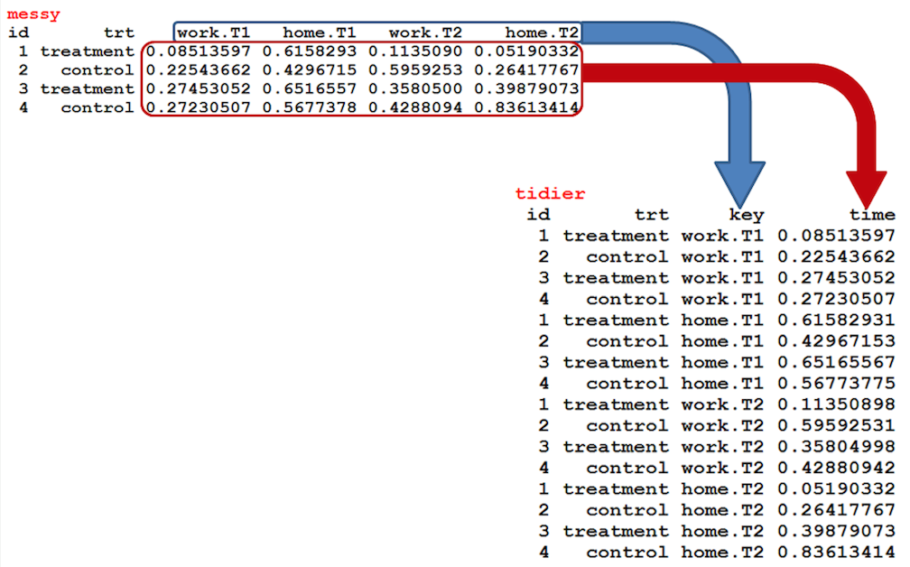
Data tidying verbs: Gather
Gather: combined multiple columns into a single column with a key-value pair format
From Boehmke 2015

Slide 8
Mess #2: Multiple variables stored in one column
Messy
Tidy
Data tidying verbs: Separate
Separate: split a single variable into multiple variables. Useful when values represent many attributes (e.g., sex and age).

Slide 9
Mess #3: Variables stored in both rows and columns
Data tidying verbs: Spread
Spread: divide key-value rows into columns
Messy
Molten
Tidy
Gather
Spread

Slide 10
Summary of data tidying verbs
gather: combine multiple columns into a single column with a key-value pair format
spread: divide key-value rows into columns
unite: merge two columns (variables) into one (pasting together)
separate: split a single variable into multiple variables. Useful when values represent many attributes (e.g., sex and age).

Slide 11
Core data wrangling verbs
filter: subset or remove observations (rows)
select: subset or remove a group of columns (variables)
mutate (transform): add or modify one or more variables
summarize (aggregate): collapse multiple values into a single value (e.g., by summing or taking means)
arrange (sort): change the order of observations

Slide 12
Other data wrangling verbs
join (Merge): Combine datasets on matching variable(s)
group_by: divide dataset according to one or more categorical variables (factors)
ungroup: Remove grouping from data operations
rename: change the names of one or more variables
recode: change the values of a discrete variable (especially factor)
slice: subset rows based on numeric order
distinct: Keep observations that are non-redundant (cf. unique)

Slide 13
Data pipelines
Traditional R uses chained function calls to join together data operations:
> arrange(summarize(filter(data, variable == numeric_value), Total = sum(variable)), desc(Total))
This syntax extends from combinations of functions in math: f(g(x)), where the functions are evaluated from inner to outer.
Although this is not a terrible syntax, it gets confusing to keep track of "the output of this function is the input to the next one."

Slide 14
Data pipelines
An alternative syntax emerged long ago from Unix terminal programming:
[mh ~] find . –iname '*.pdf' | grep –v 'figure' | sort –n
The idea of "pipes" and "redirection" in shell scripting is that the command can be read from left to right where the pipe | indicates that the output of left command is provided as input to the right command.
This syntax makes multi-step chains easier to see and conceptualize.

Slide 15
Data pipelines
The magrittr package introduced a pipe-like operator %>% to support data pipelines in R. It plays well with dplyr:
> data %>%
filter(variable == "value") %>%
summarize(Total = sum(variable)) %>%
arrange(desc(Total))
Cf.
> arrange(summarize(filter(data, variable == numeric_value), Total = sum(variable)), desc(Total))

Slide 16
Use of "this" dataset in dplyr
Sometimes it is useful to refer to the current dataset in data wrangling syntax. Dplyr/magrittr tends to hide this from us for convenience, but it's there under the hood.
iris %>% filter(Sepal.Length > 7)
is the same as
iris %>% filter(., Sepal.Length > 7)
So, "." refers to the current dataset in dplyr operations. And if you don't specify where the "." falls, it will always be passed as the first argument to the downstream function.

Slide 17
Join types
Inner join: retain (only) observations where this is a match in both datasets (left and right)
Left join: Keep all rows in left-hand dataset, add values from right-hand dataset where there is a match.
Right join: Keep all rows in right-hand dataset, add values from left-hand dataset where there is a match. For non-matching observations on the left, fill in NA
Full join: Combine observations from both datasets based on matching key and fill in NA for non-matches.

Slide 18
Special values to watch out for
NA: missing
na.rm=TRUE available in many functions
Also, see na.omit(), na.exclude(), na.fail(), na.pass()
NULL: null set
Often used when something is undefined
Inf: infinite
NaN: Not a number. Result of an invalid computation, e.g., log(-1)
Warnings(): If R mentions a warning in data wrangling, make sure you've handled it or know its origin.

